Slide 1
Developing enterprise applications
Separating infrastructure from business logic using dependency injection and interception
25/11/2015
Tomáš Bezouška

Slide 2
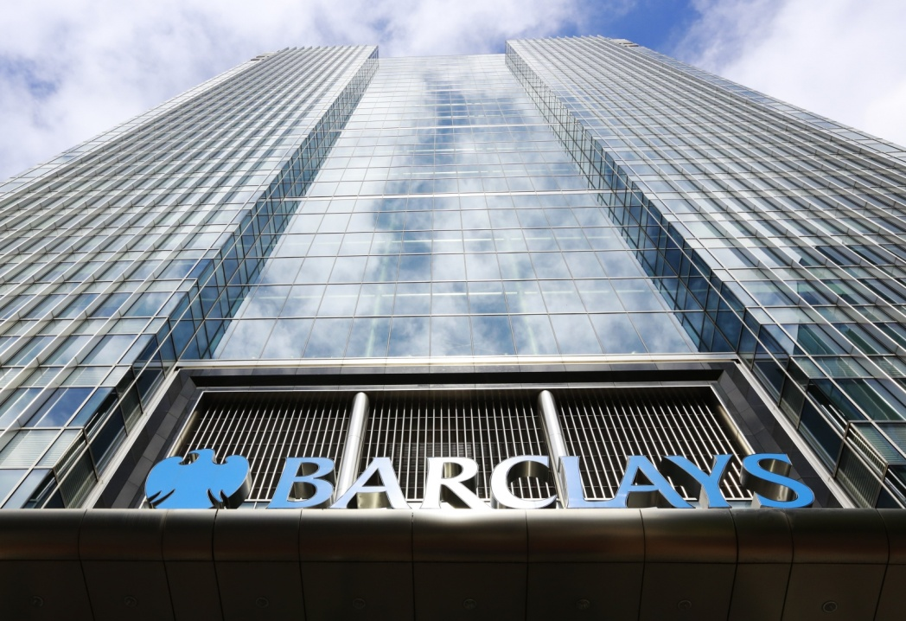
Barclays
Multinational banking company
~ 130000 employees worldwide
Several firsts
First UK credit card (1966)
First ATM (1967)
First UK debit card (1989)
First financial institution to have a website (1995)

Slide 3


Prague Office
Prague 4 - Pankrac
~400 people
Mostly C# & Java but plenty of other
Android & iOS
TypeScript
Angular
...

Slide 4
Basic pre-requisites
You should already know what followings are and how they are used:
Classes
Interfaces
Inheritance
... OOP

Slide 5
Scenario
Let’s have the following simple scenario:
Customer wants us to create a calculator
Command Line “UI”
Read input
Calculate
Write output
Repeat until empty string
Calculation must end by multiplying the result by a magic number obtained from a server
Server might get overloaded, requests timeout – retrying is needed
All entered equations / results should be logged
Naturally, customer demands that the application “must not contain any bugs” ☺

Slide 6
Time for the code

Slide 7
Separating business from infrastructure
Dynamically generate code around your implementations
Assembly weaving
Compile time – modify generated IL / Bytecode
PostSharp
Source code weaving
Pre-compile time – modify the source codes before compilation
T4
Interception
Runtime – emit new type definitions during runtime and inject custom functionality
Unity
Notes:
Even better – but still need a methods in every interface

Slide 8
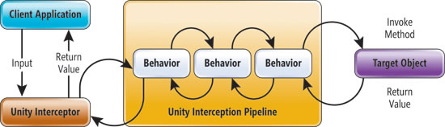
Interception pipeline
Implemented by wrapping the target object in a dynamically generated type
When method is invoked, it goes through the pipeline, after method finishes, it goes back in reversed order
https://msdn.microsoft.com/en-us/magazine/gg490353.aspx

Slide 9
Time for the code

Slide 10
Resources
Unity on github - https://github.com/unitycontainer/unity
AOP, Interception & Unity - https://msdn.microsoft.com/en-us/magazine/gg490353.aspx
PostSharp - https://www.postsharp.net
Code generation & T4 templates - https://msdn.microsoft.com/en-us/library/bb126445.aspx

Slide 11
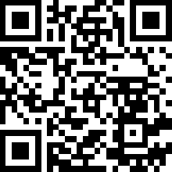
Get in touch
tomas.bezouska@barclayscapital.com
All sources we created today are available here:
https://github.com/bezysoftware/presentations
Pull requests are welcome ☺

Slide 12
Disclaimer
This document has been prepared by Barclays Bank PLC, acting through its investment bank (“Barclays”), for information purposes only. This document is an indicative summary of the terms and conditions of the securities/transaction described herein and may be amended, superseded or replaced by subsequent summaries. The final terms and conditions of the transaction and any related security will be set out in full in the applicable transaction confirmation, offering document(s), pricing supplement or binding transaction document(s).
This document shall not constitute an underwriting commitment, an offer of financing, an offer to buy or sell, or the solicitation of an offer to buy or sell any securities described herein, which shall be subject to Barclays’ internal approvals. No transaction or service related thereto is contemplated without Barclays’ subsequent formal agreement.
Barclays is acting solely as principal and not as advisor or fiduciary. Barclays does not provide, and has not provided, any investment advice or recommendation to you in relation to the transaction and/or any related securities described herein and is not responsible for providing or arranging for the provision of any general financial, strategic or specialist advice, including legal, regulatory, accounting, model auditing or taxation advice or services or any other services in relation to the transaction and/or any related securities described herein. Accordingly Barclays is under no obligation to, and shall not, determine the suitability for you of the transaction described herein. You must determine, on your own behalf or through independent professional advice, the merits, terms conditions and risks of the transaction described herein. You must also satisfy yourself that you are capable of assuming, and assume the risks of any such transaction. Neither Barclays nor any of its subsidiaries, affiliates or ultimate holding company, nor any of the subsidiaries or affiliates of such holding company (the“ Barclays Group”), nor any of their respective directors, officers, employees, representatives or agents, accepts any liability whatsoever for any direct, indirect or consequential losses (in contract, tort or otherwise) arising from the use of this document or its contents or reliance on the information contained herein.
Barclays does not guarantee the accuracy or completeness of information which is contained in this document and which is stated to have been obtained from or is based upon trade and statistical services or other third party sources. Any data on past performance, modelling, scenario analysis or back-testing contained herein is no indication as to future performance. No representation is made as to the reasonableness of the assumptions made within or the accuracy or completeness of any modelling, scenario analysis or back-testing. All opinions and estimates are given as of the date hereof and are subject to change. The value of any investment may fluctuate as a result of market changes. The information in this document is not intended to predict actual results and no assurances are given with respect thereto.
Barclays is a full service securities firm engaged in a wide range of businesses and from time to time, in the ordinary course of its business, Barclays and/or other parts of the Barclays Group may hold long or short positions and trade or otherwise effect transactions for their own account or the account of their customers in the securities referred to herein and/or the debt or equity securities, assets or loans (or any derivatives thereof) of the companies referred to herein. Additionally, Barclays and/or other parts of the Barclays Group may have investment and commercial banking, lending, asset management and other relationships with parties which are or may become involved in the transactions referred to herein and/or which may have interests which could potentially conflict with the interests of the recipient hereof. Barclays and/or other parts of the Barclays Group have in place policies and procedures to restrict the flow of information and to identify, consider and manage such potential conflicts of interest. Accordingly, you acknowledge and agree that no part of the Barclays Group is required to restrict its activities as a result of the provision of this document, and that all parts of the Barclays Group may undertake any activities without further consultation with or notification to you. Barclays shall not be required to account to you for any revenue or profits obtained in connection with any activities of the Barclays Group as referred to herein.
Barclays’ research analysts and research departments are independent from Barclays’ investment banking division and are subject to certain regulations and internal policies. Barclays’ research analysts may hold and make statements or investment recommendations and/or publish research reports with respect to any company referred to herein, the transactions contemplated herein or any person involved therein or related thereto that differ from or are inconsistent with the views or advice communicated by Barclays’ investment banking division.
Barclays offers premier investment banking products and services to its clients through Barclays Bank PLC. Barclays Bank PLC is authorised by the Prudential Regulation Authority and regulated by the Financial Conduct Authority and the Prudential Regulation Authority and is a member of the London Stock Exchange. Barclays Bank PLC is registered in England No. 1026167 with its registered office at 1 Churchill Place, London E14 5HP. Copyright Barclays Bank PLC, 2015 (all rights reserved).
This document is confidential, and no part of it may be reproduced, distributed or transmitted without the prior written permission of Barclays.

